Slide 1


SAP UI5 & FIORI with OData TRAINING
Anubhav Oberoy
Day – 1

Slide 2

INTRODUCTION

Slide 3

Agenda – Day 1
Introduction to SAP UI5
What is SAP UI5?
Client Server Architecture
Introduction of MVC Architecture
UI5 Development Tools
Installation of development Tools
Introduction to HTML
Important Points related to HTML
Trainer: Anubhav Oberoy & Nishan

Slide 4


What is SAP UI5?
SAPUI5 (SAP user interface for HTML5) is a collection of libraries that you can use to build desktop and mobile applications that run in a browser. With the SAPUI5 JavaScript toolkit, you can create web applications using HTML5 web development standards.
SAP UI5 is a framework which is used to develop Responsive web applications to run on any platform, any browser and any OS.
Responsive
App which can adapt itself according the different devices
Framework
It’s a collection of Libraries.
Library
Collection of classes.
Classes
Collection of methods, Attributes, Events
Software Innovation
Hardware Innovation
Trainer: Anubhav Oberoy & Nishan

Slide 5
Evolution of SAP UI Technologies
Dynpro
Web Dynpro
WebGUI
BSP
SAPUI5
SAP FIORI 1.0
(2013)
SAP FIORI 2.0
(2016)
SAP FIORI 3.0
(2018)
A Small set of 25 application for tablet and phone
Desktop Scenarios
Native for iOS
More Advanced Features on the launchpad and overview pages
More Scalable content
Machine Learning Techniques Implemented
Native for Android
Trainer: Anubhav Oberoy & Nishan

Slide 6
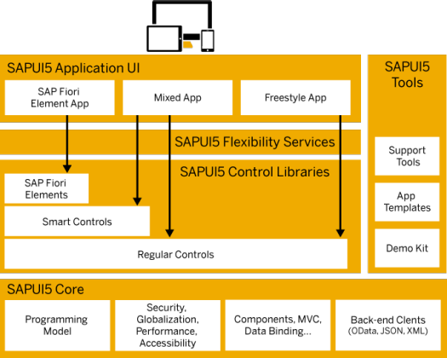
Under the Hood of SAP UI5
SAPUI5 simplifies web application development. A variety of UI controls, ranging from basic elements to complex UI patterns, can be combined for an appealing layout. All UI controls leverage a consistent design language and coherent UX patterns. SAPUI5 flexibility services let you easily adapt the UI of an app and store the changes in a layered repository.
Trainer: Anubhav Oberoy & Nishan

Slide 7
Client Server Architecture
The task of the client/server technology components is to provide a reusable runtime environment for other components that use the client server technology as the basis on which to process requests. The focus is on optimizing operating system resources (CPU, memory, etc.), in terms of performance, scalability, and robustness.
In addition to the components in the SAP kernel there are programs that regulate data traffic in the network, such as the SAP router and the SAP Web Dispatcher, as well as smaller monitoring and test programs.
SAP
Server
Computer on cloud
IP Address
Fiori
Request – header + body(optional)
Response – header + body(html,xml, json,excel, pdf, word,….)
Request Types
GET – Read Data
POST – Create new Data
PUT – Update
DELETE – Remove Data
Trainer: Anubhav Oberoy & Nishan

Slide 8
Introduction to MVC Architecture
MVC stands for Model, View, Controller.
Model:- The model component is a freely composed class that will keep the application data and do manipulations on it. All database accesses are done within the model.
View:- The View is responsible for defining the user interface to users. When a user sends a requests from his device, the view is responsible for data view as per the request submitted.
Controller:- The Controller is used to control the data and view events as per user interaction by updating the view and model.
<event>
Processing
Controller
eventHandler
<notifies>
<done>
<modifies>
I/O
View
Data binding
Data
Models
MVC Architecture

Slide 9

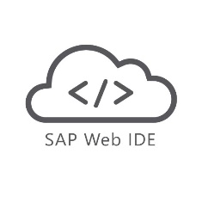

UI5 Development Tools
Development Tools
BAS is the latest technology provided by SAP for Development
Eclipse
Web IDE
SAP Web IDE comes in two type
Business Application Studio (BAS)
Eclipse development tools is Obsolete
It is no longer supported by the SAP
But we can still use it for local development in our system.
This tool is a Dead technology.
Web IDE Personal Edition
Web IDE Full-Stack
SAP Business Application Studio is the next generation of the iconic SAP Web IDE.
It comes out of the box with predefined set of development environments – Dev-Spaces (virtual machine on the cloud) tailored for developing SAP business scenarios.
It Installs in our local system and runs on the browser.
It requires JAVA 1.8 to be installed in system.
It runs offline.
Support for Web IDE is also stopped by SAP in 2019.
SAP Web IDE Full-Stack runs on SAP Cloud Platform
It needs no installation
It allows you to integrate with other services that run on the platform
SAP Fiori Cloud apps
Git integration
mobile services
IoT services and more.
Trainer: Anubhav Oberoy & Nishan

Slide 10


UI5 Development Environment
Local Computer
No internet required
Required admin rights to install software
Convenient
Responsible for backup
Faster
Almost no cost
Port application to another PC/laptop manually
System crash everything goes
Hardware cost (8 GB RAM, 100 GB, > i3)
Options
SAP WebIDE (obsolete)
VS Code (recommend)
Cloud Computer
Internet required
No installation required
Convenient (cant develop when offline)
Source code is on cloud
Moderate (depends on speed)
Almost no cost for 365 after that you need to pay
Switch device (suitable for corporate laptops)
System crash wont affect us
Low cost and faster adoption
Options
Business Application Tool (BAS) – 365 days is free
Trainer: Anubhav Oberoy & Nishan

Slide 11
Installation of the Development Tools
VS code:
VS code a open source development tool (IDE) by Microsoft for developer community. Billions of developers across industry use this tool for all kinds of development (web, android, ERP apps, Fiori). Hence SAP also recommend to follow industry best practice. The BAS is a copy of VS Code (local BAS). If you adopt VS Code, you don’t need to buy SAP BAS subscription so it’s a cost saving for company.
Pre-requisites
Node JS to be installed (min v10) – node –v
Download and install NodeJS from here
We need to install SAP UI5 tooling used by Node JS (support module to work with ui5 apps) – npm install –g @ui5/cli
Steps to install VS Code
Download and install VS Code for free from here
Open the VS Code
Add A folder C:\UI5 Project\basics ← project name
Create webapp/index.html file and same content like Web IDE
Run following command by opening terminal in VS Code and go inside project directory
npm init
ui5 init
6. Inside the webapp folder, create a file manifest.json
7. Start web server using command ui5 serve
Trainer: Anubhav Oberoy & Nishan

Slide 12
Installation of the Development Tools
Click on GO
Create free trial account
Launch your cloud platform
trial cockpit - Click
BAS SETUP
On main screen you will see BAS
Click and Create Dev Space &
choose Fiori as Dev Space Type
Trainer: Anubhav Oberoy & Nishan

Slide 13
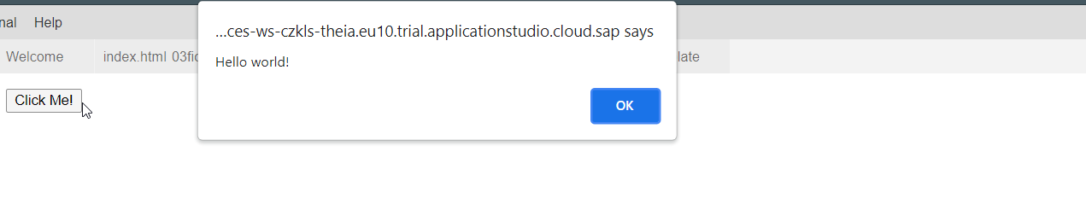
Creating First Program In HTML
Create a Program with a Button using below code:
Code:
<html>
<body>
<button type="button" onclick="alert('Hello world!')">Click Me!</button>
</body>
</html>
Output:
Trainer: Anubhav Oberoy & Nishan

Slide 14
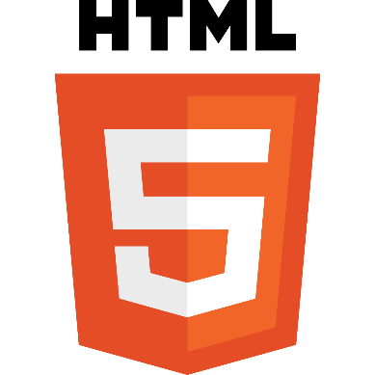
Introduction to HTML
HTML stands for Hyper Text Markup Language, It is used to design static web content. HTML is developed and designed by org named W3C – World Wide Web Consortium.
Markup language is used to define the text document within tag which defines the structure of web pages.
HTML5 is the fifth and current version of HTML. It has improved the markup available for documents and has introduced application programming interfaces(API) and Document Object Model(DOM).
HTML5 is not the next iteration of XHTML. In fact many of the rules that you are accustomed to from your familiarity with XHTML are now changed in HTML5.
HTML5 places the highest value on the user of the website over the HTML craftsman.
Web Visualization with HTML5, CSS3, and JavaScript is the course with the rapidly changing web development technologies, it has become important to stay in line with them to progress within the industry, which is why this course in web virtualization has been brought to you to spruce up your web designing and animating skills using HTML5, CSS3, and JavaScript.
History of HTML
Year | Version
1991 | HTML
1993 | HTML 2.0
1997 | XHTML
1999 | HTML 4
2014 | HTML 5
Trainer: Anubhav Oberoy & Nishan

Slide 15
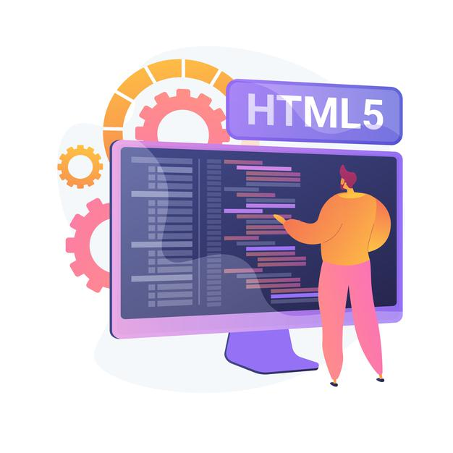
Some Important Points in HTML
HTML pages contains a header and a body, the body is what user sees.
HTML is a tree data structure
Each HTML element is called tag, we will have starting and ending tags.
Syntax
<tagName property=“value”>Content</tagName>
We can excess the Browser Dev Tools and Developer Toolbar by pressing F12 in the browser window.
HTML is not a programming language, it’s a markup language.
When we test HTML page in Browser, the generated tree data Structure is known as DOM – Document Object Model.
We can excess the HTML Documentation at https://www.w3schools.com/

Slide 16

End of Day 1

Slide 17

Questions
Trainer: Anubhav Oberoy & Nishan

Slide 18

Anubhav Oberoy

Slide 19


We’re committed to empower you to be
Most Desirable Resource
through powerful training solutions.
We build the workforce of the future.
250+
Corporate Clients
30,000+
Learners Trained
25000+
Learners Placed
FREE WEBINARS
Sign up for free webinars with industry experts every fortnight!
Enroll Now!
Contact us today!
https://anubhavtrainings.com/

Slide 20




More from AnubhavTrainings.com

